Slide 1
PART OF COMPUTER
GRADE 1

Slide 2
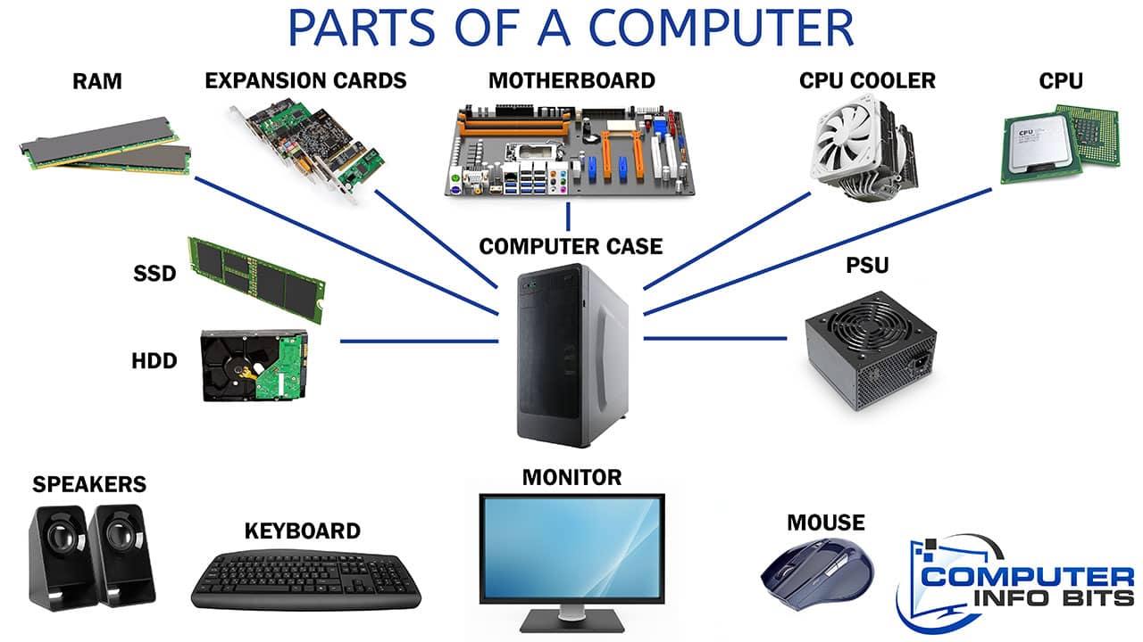
PART OF COMPUTER

